Slide 1

AI Coding Agents Need Specs, Not Vibes.

Slide 2
01
02
03
SDD (Spec-Driven Development) Windsurf
Starting a Greenfield Project with Spec Kit
Pag. 2
Pag. 10
Pag. 12

Slide 3
SDD (Spec-Driven Development)
01

Slide 4
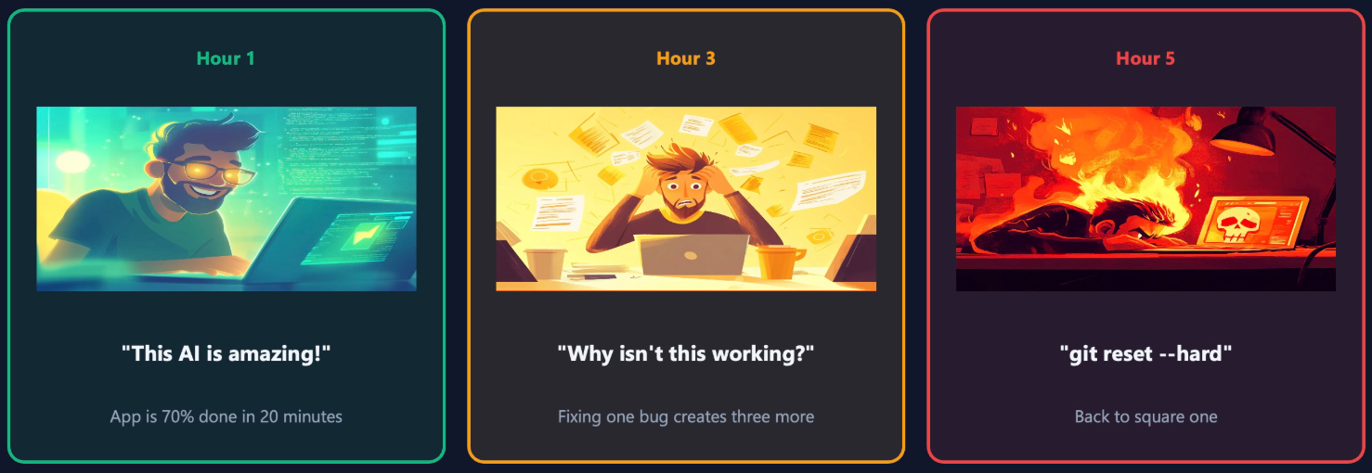
SDD (Spec-Driven Development)
The Problem Everyone Recognizes
AI can write code fast. So why do we still get wrong implementations?
Fast output does not guarantee correct output
Vague prompts create hidden assumptions
The first version often looks right, but misses intent
Rework starts after code already exists
Code generation is cheap now, but good code still has a cost, and new habits are needed around coding agents.

Slide 5
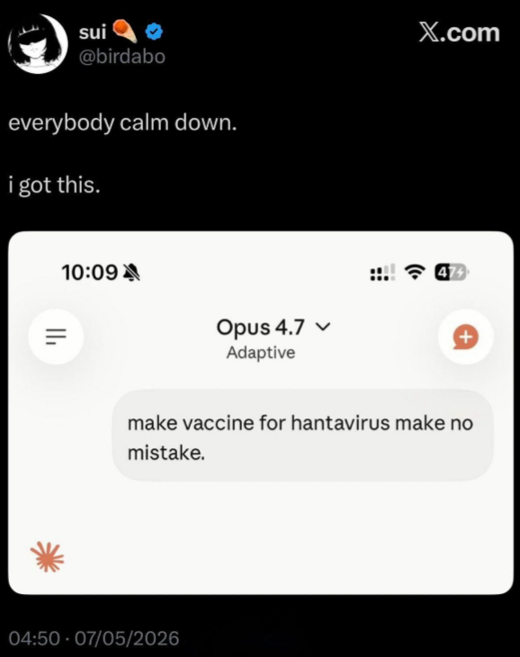

SDD (Spec-Driven Development)
Vibe Coding and Why It Breaks
Example prompt: "Build me a project management app."
Now the agent must guess:
User roles
Permissions
Workflows
Data model
Edge cases
Success criteria
Vibe coding is useful for exploration. It is risky for delivery.
AI-generated code is only good as the instructions that created it! Garbage in Garbage out

Slide 6
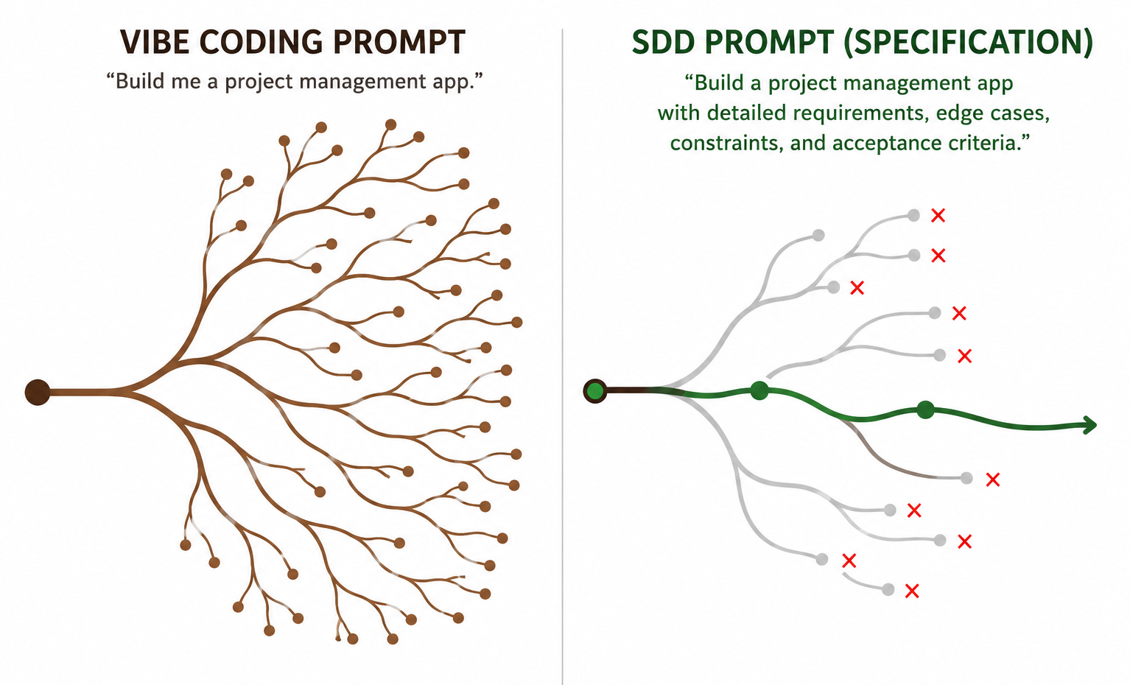
SDD (Spec-Driven Development)
What SDD Actually Changes
Spec-Driven Development changes the source of truth.
Instead of:
Prompt first
Code first
Requirements discovered later
Agent makes hidden decisions
SDD means:
Intent first
Spec first
Code follows the spec
Result is verified against the spec

Slide 7
SDD (Spec-Driven Development)
What a Good Spec Contains
Useful sections:
Outcome
Scope / non-goals
Constraints and assumptions
Key decisions
Acceptance criteria
Verification notes
A good spec answers:
What should be true when this is done?
What is in scope?
What is explicitly out of scope?
What constraints must be respected?
What decisions are already fixed?
How will we verify success?

Slide 8
SDD (Spec-Driven Development)
How SDD Works in Practice
Framework-neutral SDD workflow:
Start with intent
Clarify behavior
Define scope and non-goals
Capture constraints
Add acceptance criteria
Let the agent implement
Review against the spec
SDD is a way to reduce ambiguity before code is written.

Slide 9
SDD (Spec-Driven Development)
When Not To
When to Use SDD
The work is real, shared, or long-lived
Acceptance criteria matter
Multiple people or sessions are involved
The feature affects architecture
You are changing an existing system
Mistakes are expensive to reverse
Small bug fixes / trivial tweaks
The task is tiny
The work is exploratory
The result is disposable
Mistakes are cheap

Slide 10
Windsurf
02

Slide 11
Windsurf
Windsurf Orientation
Subscription Cognition Platform (Enterprise)
Project explorer
Terminal
Settings Disable: Auto Execution, Auto Web Requests, Auto-Continue
Cascade
Modes Ask, Plan, Code
Models AGPT vs Claude, Thinking, Pricing

Slide 12
Starting a Greenfield Project with Spec Kit
03

Slide 13
Starting a Greenfield Project with Spec Kit
GitHub Spec Kit Installation Guide
Prerequisites
Python
uv for package management
Installation
uvx --from git+https://github.com/github/spec-kit.git specify init --here
Or just download the sample project with already installed spec kit from:
https://github.com/MTrajK/engineering-notes/ - TODO UPDATE THE FULL LINK

Slide 14
Starting a Greenfield Project with Spec Kit
GitHub Spec Kit Folders Structure
.specify folder
all the Spec Kit related configuration and artefacts are located here (scripts, templates, memories)
.windsurf folder
all the windsurf configuration and artefacts are located here (workflows, skills, rules)

Slide 15
Starting a Greenfield Project with Spec Kit
Constitution
/speckit.constitution The constitution should not be invented by the agent. It should be distilled from project intent, delivery standards, and quality expectations. The constitution is not the product brief. It is the project’s technical operating system.
Runs once at project start
Defines long-lived rules for the project
Should include:
architecture principles
tech stack constraints
code quality expectations
testing expectations
security/privacy rules
accessibility/logging/error handling
do not put detailed feature requirements here

Slide 16
Starting a Greenfield Project with Spec Kit
CONSTITUTION.md
Used by GitHub Spec Kit
Project principles and governance used by Spec Kit.
AGENTS.md
Used by AI Coding Agents (Windsurf in this case)
Agent behavior and project conventions used by Windsurf/Cascade. Use AGENTS.md if you want durable, team-shared instructions for Cascade. It is not where the product vision belongs.
README.md
Used by humans
Human-facing project introduction. Project’s front door for humans: quick starts, project descriptions, and contribution guidelines.

Slide 17
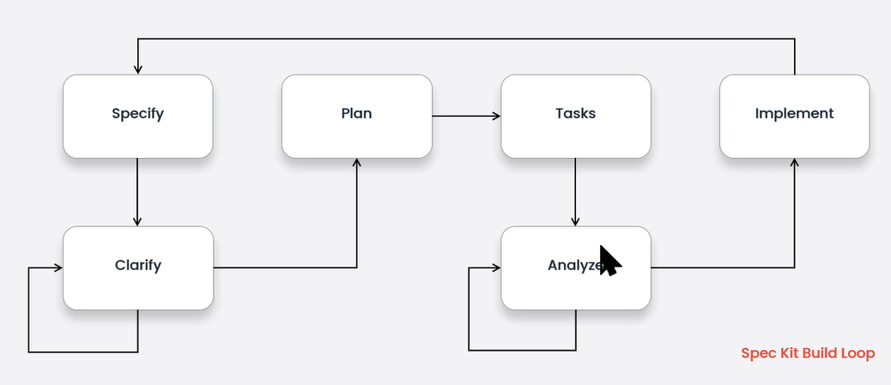
Starting a Greenfield Project with Spec Kit
GitHub Spec Kit Ceremony

Slide 18
Starting a Greenfield Project with Spec Kit
Business / Product Requirements
/speckit.specify
Describe what and why
Focus on users, scenarios, rules, outcomes
Avoid tech stack here
/speckit.clarify
Resolve ambiguity before planning

Slide 19
Starting a Greenfield Project with Spec Kit
Technical Implementation
/speckit.plan
Technical approach, stack, architecture
/speckit.tasks
Ordered implementation tasks
/speckit.analyze
Consistency check before coding
/speckit.implement
Agent executes the plan

Slide 20
Q&A

Slide 21
Thank you!

